Slide 1
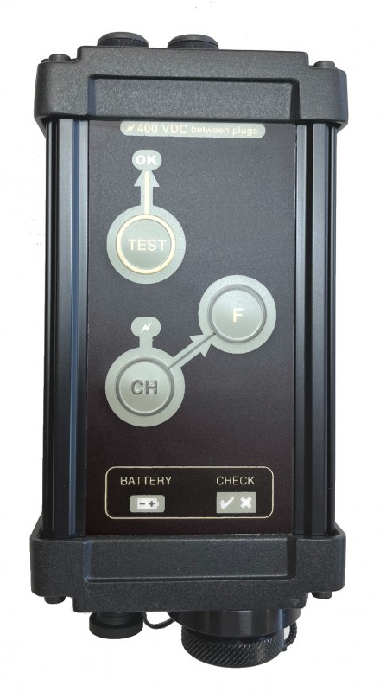
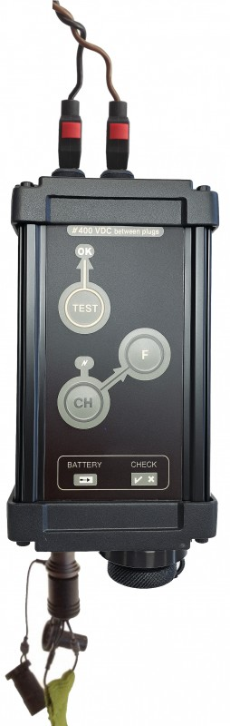


INITIATORS AND RIGGING LINES
Wired exploder ATLAS-390
Manufactured by SCOPEX, ATLAS-390 is a hard wired electronic exploder, designed for firing of electric detonators.
DESCRIPTION
Robust and powerful, ATLAS-390 features one firing output, equipped with safety sockets, in order to avoid that the user can be in contact with the dangerous output voltage. Safety banana plugs are supplied for the connexion of the firing cable.
This exploder also integrates a line-continuity test, that allows to check the continuity of the firing cable.
The rugged aluminium box is waterproof IP 67, black color, and equipped with a polyester control panel, which integrates the buttons and the lights.
The LEDs’ luminosity level can be selected by the user and thus adapted to the work conditions (day/night).
This exploder features many security levels :
Security key
Automatic discharge of the capacitors when the charge button is released
Permanent measurement of the capacitors voltage
To fire 2 buttons must be pressed simultaneously
Firing is allowed only when the capacitors are charged enough
Permanent shunt on the firing output
Battery voltage monitoring
Safety sockets and plugs
Monitoring by micro-controller
Self-test of the control panel lights
Redundancy of certain functions
SPECIFICATIONS
Enclosure : Robust aluminium
Watertight : IP67
Dimensions : 175 x 80 x 75 mm
Weight : Environ 500 g
Power supply : 3 lithium CR 123 batteries
Autonomy : > 300 firings at 20°C
Firing output : 1
Internal shunt : Yes
Charging voltage : 390 V maximum
Energy : 14 J maximum
Charging time : 4 sec.
Operating temperature : -20°C to 55°C
Standards : CE conformity
Line continuity test integrated

